Slide 1
MIS 221
Lab 2 – Source Control and Variables

Slide 2
What is Source Control?
Most people have used a simple form of source control in the form of Save As saving different versions of files
MIS221_PA1_V1.doc
MIS221_PA1_V2.doc
Source control, also known as version or revision control, is a system that records changes to a file or set of files so we can recall previous versions if needed

Slide 3
Git
Git is the most popular source control system for developers
Designed for version control and coordinating work among a team of programmers
Can be used to track changes in any file
Git is a distributed version control system
Distributed = every computer has a fully fledged repository
Repository = contains your projects files and file history.

Slide 4
GitHub
GitHub is a hosting service for Git repositories
Git is a tool. GitHub is a service for projects that use Git
You do not need GitHub if you just need version control for your own project
GitHub allows you to share your changes with other developers
For this class we’ll use Git for version control with our projects and GitHub to turn in assignments for grading.
Each student will have a private repository to clone assignments from and submit assignments for grading

Slide 5
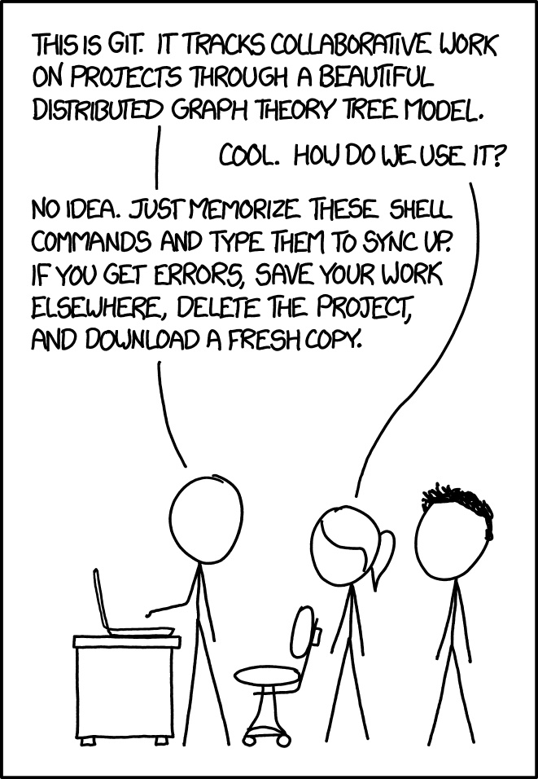
Git

Slide 6
Generate Personal Repo from Starter Link
We will use a tool provided by GitHub to manage classroom submissions
The tool will provide a link that each student can navigate to. That link will create an individual repo for each student that the instructors and TAs have access to.
The link will change for each assignment. For this assignment, the link is: https://classroom.github.com/a/QEWEy_4m
Copy the generated link and Accept the assignment
(Make sure you refresh the page after accepting)

Slide 7


Now let me tell you about:
Variables
Data Types
Math
Console

Slide 8
Basic GitHub Commands
Enter these commands into your terminal
Obtain the url at the top of the browser or by clicking code and the copy icon
git clone <url copied in previous step>
Do not include the <> brackets when pasting in Url
git add .
Stages your changes
git commit –m”some message”
Commits your changes
git push
Sends your changes to GitHub

Slide 9
Lab Requirements
Create "Penny Pincher's Quest," an application for the magical guilds to track the expenditure on their enchantment orders.
The application will collect the number of spells and ingredients that the user needs, and calculate the total gold owed to the traveling merchant.
There is a 5.27 gold pieces flat fee to the merchant per order. The base cost for a spell is set at 10 gold pieces, with an additional 0.25 gold pieces per magical ingredient. The guild members can also input their generous offerings (tips) as a decimal for extraordinary service.

Slide 10
Me when the traveling merchant has a 2 for 1 special

Slide 11
IPO
Input | Processing | Output
numberOfSpells numberOfMagicIngredients offerings | Processing items: totalSpellCost totalIngredientCost totalMerchantPayment MERCHANT_FLAT_FEE COST_OF_SPELL COST_OF_MAGIC_INGREDIENT Prompt user for the number of spells Input numberOfSpells Prompt user for the number of ingredients needed Input numberOfMagicIngredients Prompt user for the offerings Input offerings totalSpellCost = COST_OF_SPELL * numberOfSpells totalIngredientCost = COST_OF_MAGIC_INGREDIENT * numberOfMagicIngredients totalMerchantPayment = FLAT_FEE + offerings goldOwed = totalSpellCost + totalIngredientCost + totalMerchantPayment Display goldOwed | goldOwed

Slide 12
Saving Code In GitHub
Run the following commands when you want to save your work:
git add .
git commit –m "Some message"
git push

Slide 13
Administration
Due 1/29 at 2 pm
Worth 50 points in the Lab, Quizzes, and Participation category
Push code up to GitHub and submit the link to the repository in Blackboard.

Slide 14
Reference
Software Install Videos:
Software Installation
Software Installation Introduction
*** NOTE *** Please install dotnet 7, not dotnet 6. A new version has been released since these videos were recorded.
Dotnet Install (Windows)
Dotent Install (Mac)
VSCode Install
VSCode Packages
CMDER Install (Windows)
Git install (Windows)
Brew Install (Mac)
Git Install (Mac)
Git and Github (Mac)
Git and Github (Windows)

